Slide 1
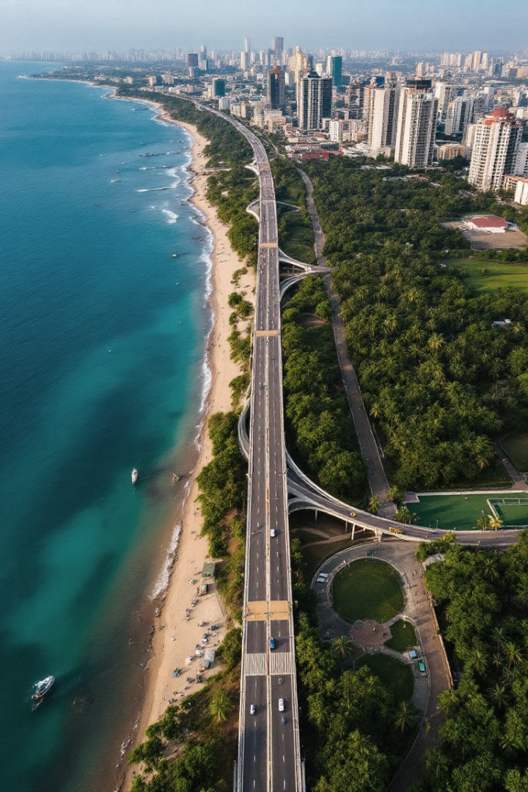
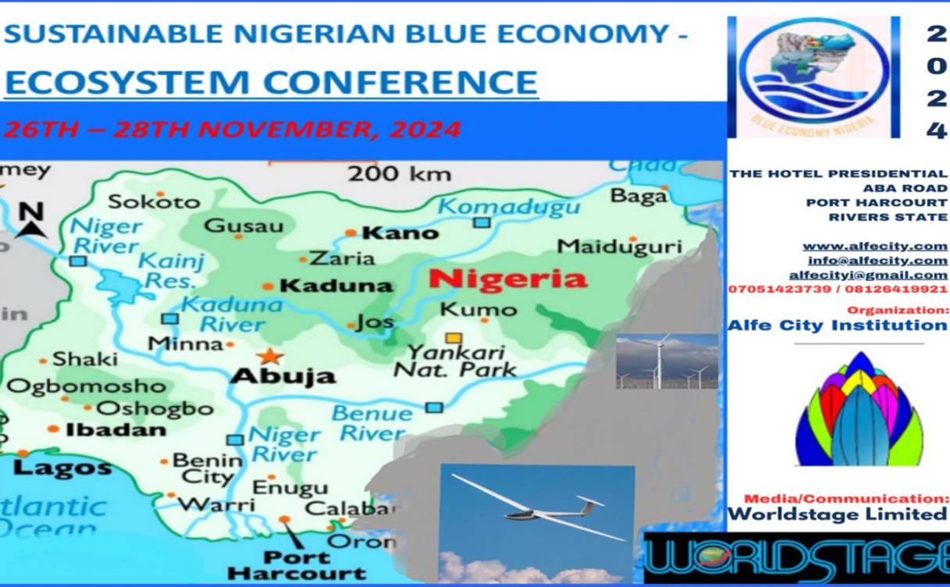




THE ENGINEERING BEHIND THE LAGOS-CALABAR COASTAL HIGHWAY PROJECT:
The environmental considerations, sustainability and potential contribution to a
sustainable Nigerian Blue Economy
@
Ecosystem Conference of the
Nigerian Blue Economy
Presented by:
Dr. Eugene Itua,
Lead, Environmental and Social Safeguards,
Lagos-Calabar Coastal Highway
November 27, 2024, Port Harcourt, Nigeria

Slide 2
Presentation Outline
Overview of the Project
Importance of the Project
Engineering Consideration
Environmental Considerations:
How it aligns with and promote Nigeria's commitment to and promoting the blue economy.

Slide 3
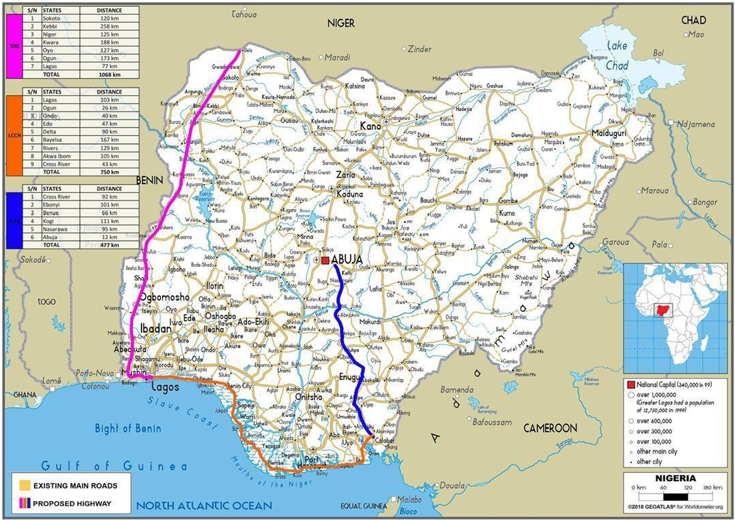
Lagos-Calabar Coastal Highway
spans approximately 700 kilometers, connecting Lagos to Calabar.

Slide 4
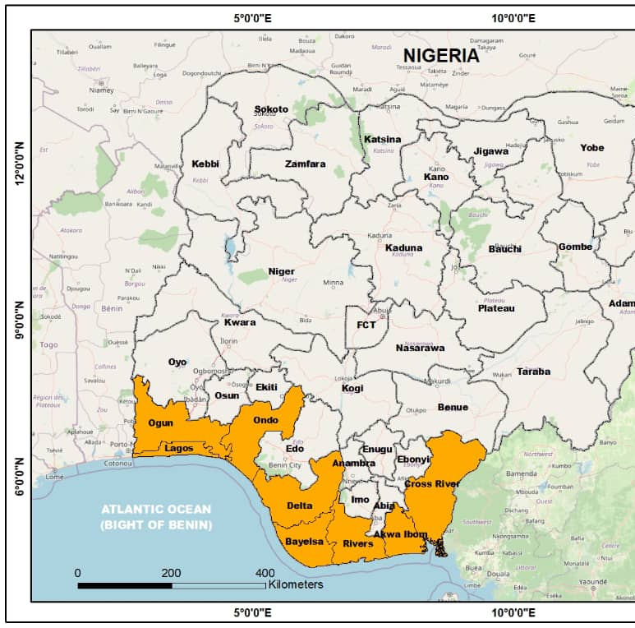
Proposes to pass through several states, including Lagos, Ogun, Ondo, Delta, Bayelsa, Rivers, and Akwa Ibom

Slide 5
Project Overview
Aspect | Details
Project Components | A 700 km coastal highway linking Lagos to Calabar through nine coastal states. Integration of transportation modes with a future railway median. Aims to enhance connectivity, reduce travel time, and support economic growth. Alignment with Nigeria's Blue Economy vision by fostering regional trade and tourism.
Highway Width | 59.3m with a rail median of 20m 33.5m with a median of 4.5 for Lighting Schemes
Rail Integration | For Km 10 to km 71km a width of 20m median is proposed along the highway for rail provision that will be designed and developed at a future stage.
Highway Speed | 50 km/h from PK 0+000 to PK 10+000. 100 km/h from PK 10+000 to end of project
Start and End of Section 1 | The first phase of the highway covers a 47.5kilometer section starting from Victoria Island in Lagos.
Highway Features: | Five lanes on each side of the dual carriageway Train track running through the middle. 50 culverts Solar powered lighting system using LED lamps
Infrastructure and Utilities | The relocation works for the existing Electrical and Telephone networks Crossings ducts for future extension of the electrical and telecom network. .

Slide 6
Project Overview
The Lagos-Calabar Coastal Highway Project is a significant infrastructure initiative in Nigeria.
Economic Impact:
aims to enhance connectivity between major coastal cities, boosting trade, tourism, and economic activities along the southern coast of Nigeria
Construction Timeline:
began in March 2024 and is expected to be completed by 2031. The project is being executed in phases, with the first phase covering 47.47 kilometers from Lagos
Resilience and Sustainability:
Given the coastal location, the highway is being designed with climate resilience in mind to withstand rising sea levels and extreme weather conditions
This project is poised to transform transportation and economic dynamics in Nigeria.

Slide 7
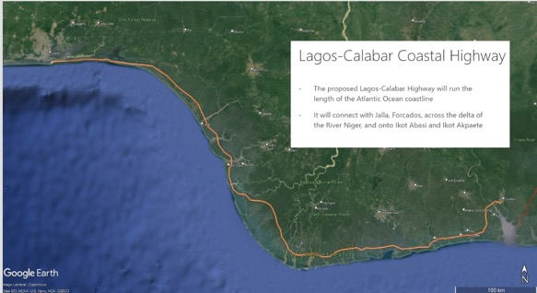
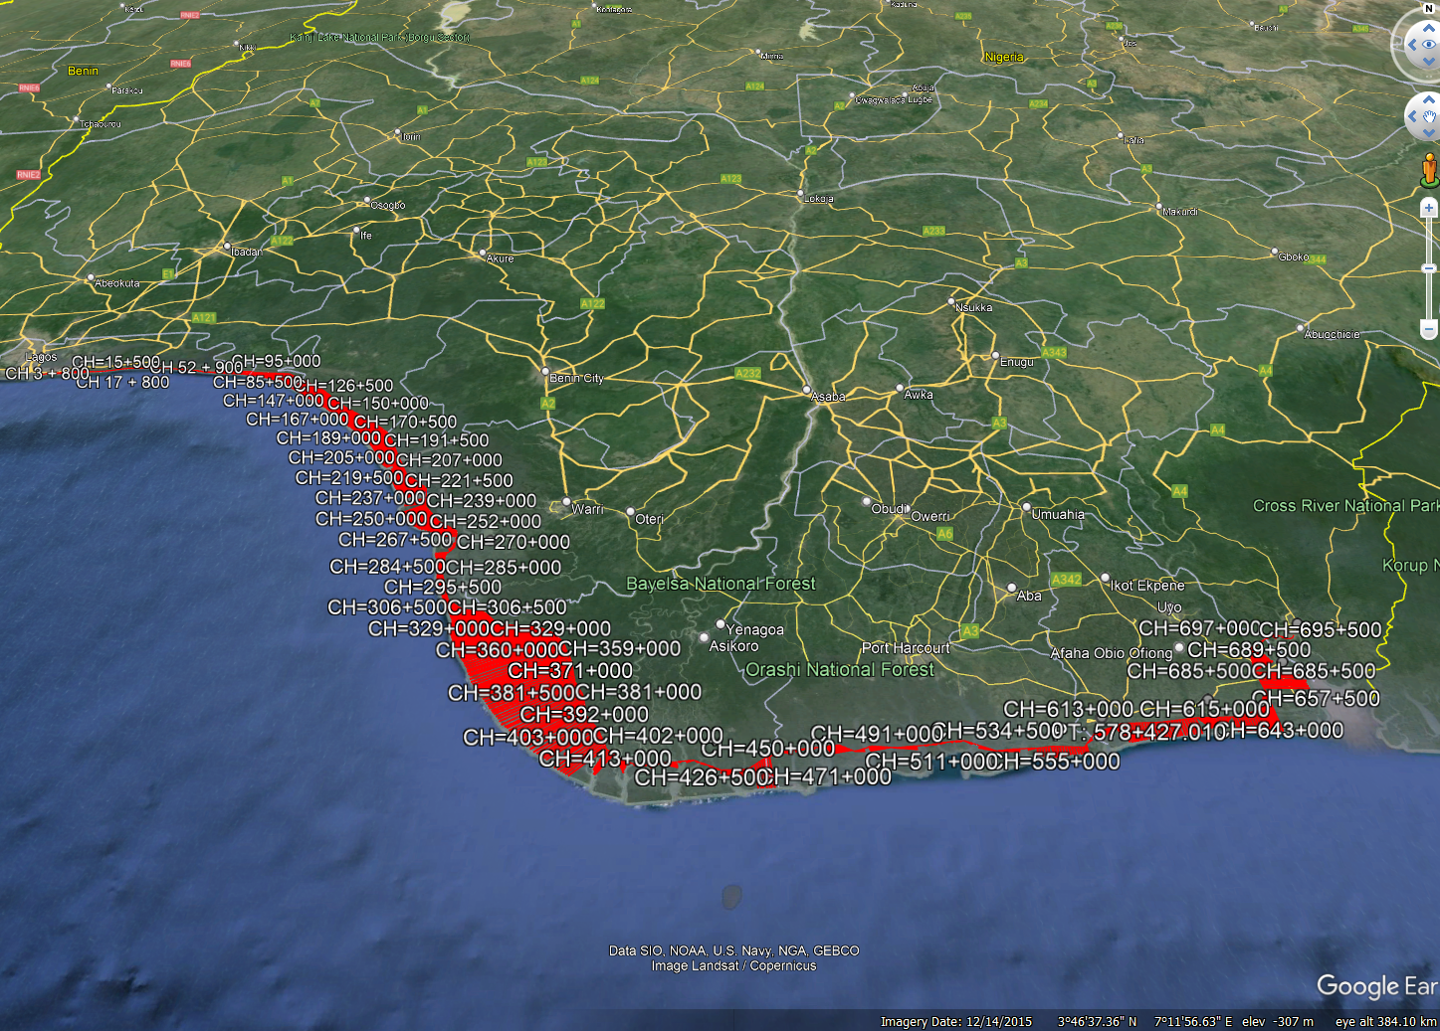
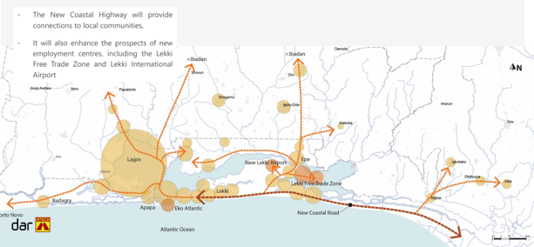
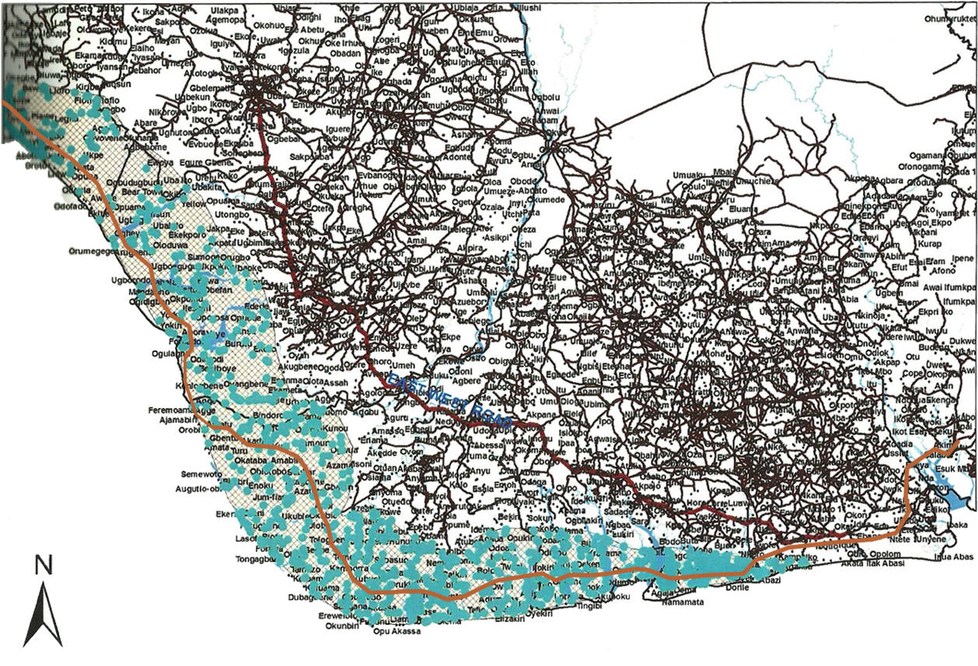
Lagos-Calabar Coastal Highway-Overview
Opening up areas Inaccessible by Road in the Coastal Zone

Slide 8
Critical Question in Bringing the Coastal Highway to Be
How can we prioritise sustainability and responsible construction and operation practices and achieve the project goal and objectives?

Slide 9
Engineering Considerations
Route Planning and Design:
Conduct comprehensive ESIA to identify and mitigate ecological impacts.
Optimize highway alignment to avoid sensitive areas like wetlands and wildlife habitats.
Construction Techniques:
Use sustainable materials and innovative construction methods to minimize environmental footprints.
Implement practices that reduce land disturbance and preserve existing vegetation.
Water Management:
Develop stormwater management systems to control runoff and protect water quality.
Incorporate coastal protection measures against erosion and rising sea levels.

Slide 10
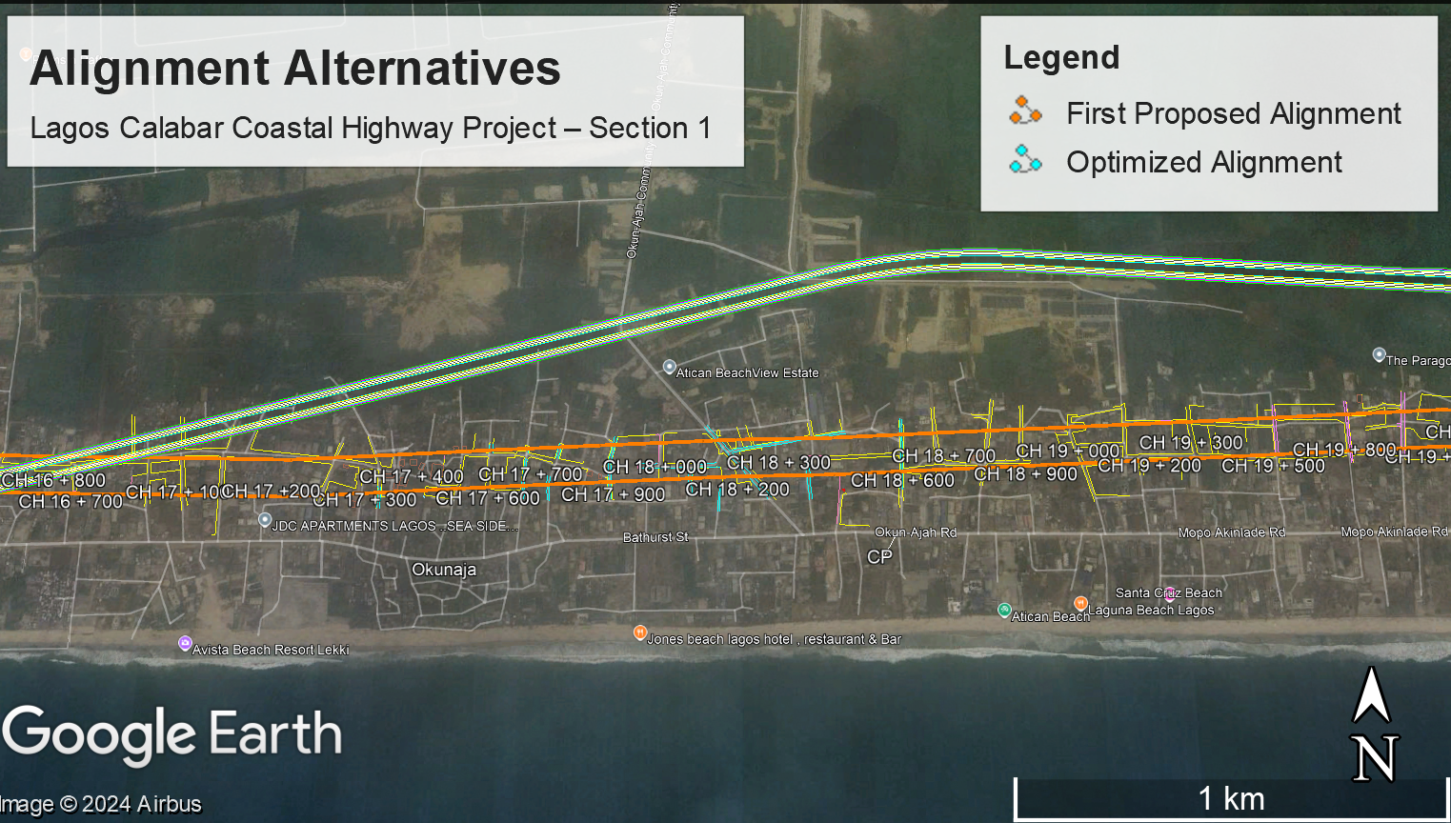
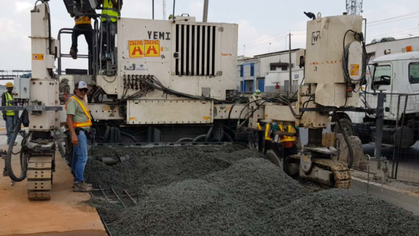
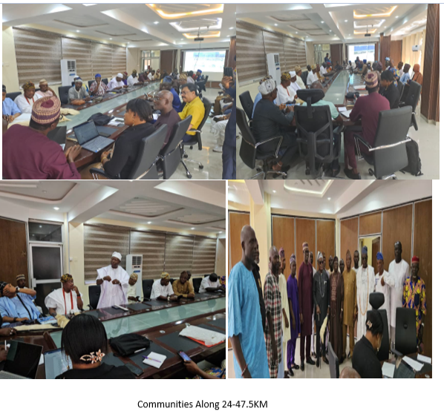
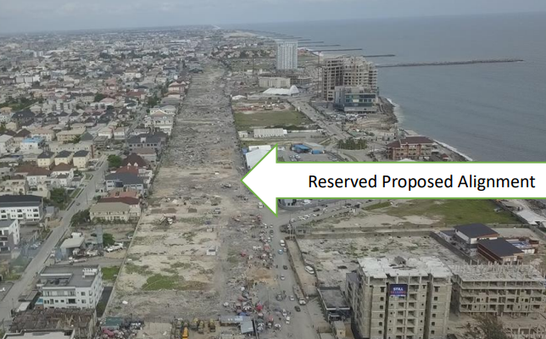

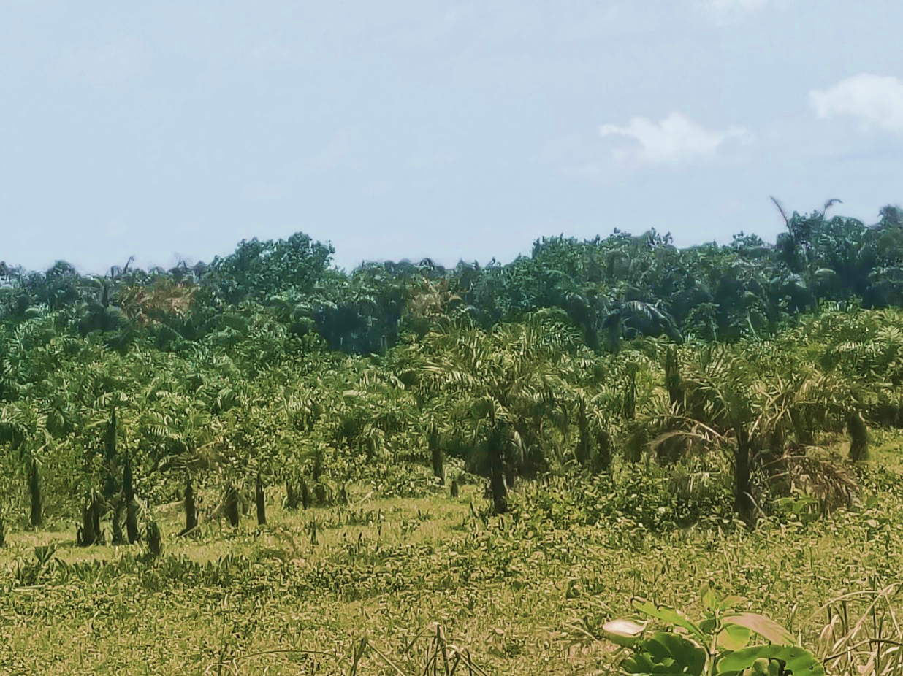


SUSTAINABILITY IN ENGINEERING
SUSTAINABLE PRACTICES INCORPORATED INTO THE PROJECT
Economic Sustainability
Local job creation, trade facilitation, and tourism promotion.
Technical Sustainability
Use of Continuous Reinforced Concrete Pavement (CRCP) for durability and minimal maintenance.
Environmental Sustainability
Biodiversity Action Plan; reforestation; Integration recycled materials.
Social Sustainability
Stakeholder engagement for alignment optimization, grievance redress and compensation under the RAP.
Durability, lower maintenance, recyclability

Slide 11
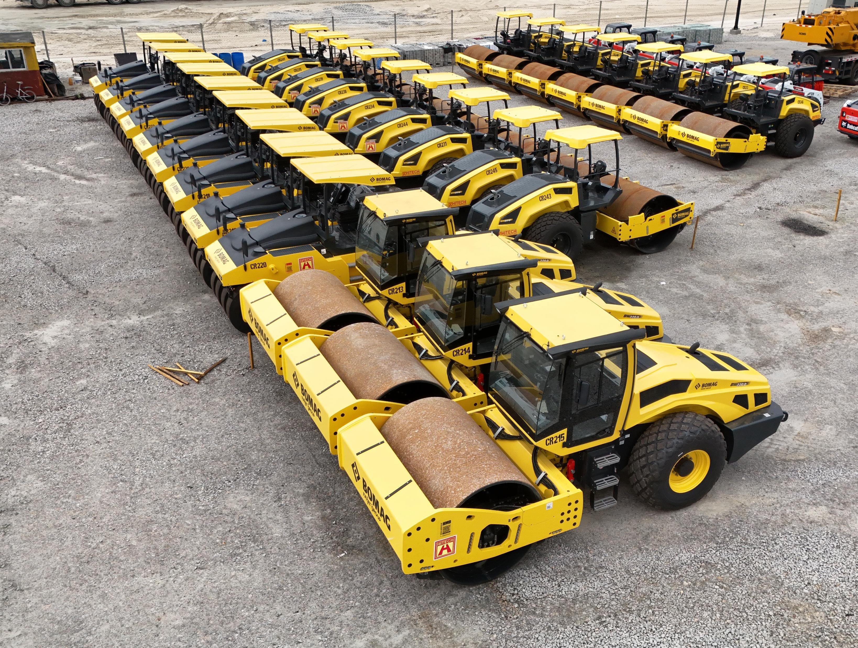

The Project integrates Best Available Techniques (BAT) across design, construction, and future operational phases to ensure environmentally and socially responsible development.

Slide 12

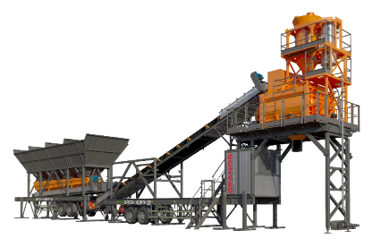
Best Available Techniques (BAT) for Sustainable Construction
By adopting BAT, the project minimizes environmental impacts
while enhancing performance, safety, and compliance with rigorous international standards
Wirtgen CRCP Equipment (WR 240, SP124, and TCM 180) | Sustainable pavement construction with advanced features for efficiency and environmental protection. The WR 240 soil stabilizer reduces material usage by recycling existing soil, while the SP124 paver ensures precision in concrete placement, enhancing durability and minimizing material waste. The TCM 180 texture curing machine provides optimal curing conditions, reducing cracks and extending pavement life. Together, these Wirtgen models offer fuel efficiency, precise performance, and sustainable outcomes, making them ideal for high-quality, long-lasting pavement projects.
Ecobatch SPANOS | The SPANOS 135 m³/hr Mobile Batching Plant incorporates advanced environmental features aligned with the Best Available Technology (BAT) approach. It minimizes dust emissions through an integrated filtration system, conserves water by recycling unused water, and reduces material waste with precise mixing capabilities. Noise control measures keep operations within permissible levels, while modern emissions controls ensure compliance with air quality standards. Its energy-efficient design and recyclability of components further enhance sustainability, supporting eco-friendly concrete production for the Lagos-Calabar Coastal Highway.

Slide 13

Leveraging the Unique Contributions of Cement
To enhance the resilience, sustainability, and economic viability of the Lagos-Calabar Coastal Highway
Aspect | Unique Contributions of Cement
Durability and Longevity | Extended Lifespan: Concrete roads, made from cement, last 20-40 years, reducing the need for frequent repairs and replacements.
Resistance to Extreme Weather | Water Resistance: Concrete does not soften or rut under prolonged water submersion or heavy rainfall, making it ideal for flood-prone coastal areas. Heat Resistance: Withstands high temperatures without deforming.
Environmental Benefits | - Lower Emissions: Advances in cement production can reduce CO2 emissions by up to 40%. Recyclability: Concrete is 100% recyclable, reducing waste and the need for new raw materials.
Energy Efficiency | Thermal Mass: Concrete’s thermal mass helps regulate temperature, reducing the need for air conditioning and heating.

Slide 14
Unique Contributions of Cement
Local Resource Utilization:
The highway project uses locally sourced materials, including cement, which supports the local economy and reduces transportation emissions.
Structural Integrity:
The use of reinforced concrete (with steel) enhances the structural integrity of the highway, making it more resilient to natural disasters such as coastal flooding and erosion.
Economic Impact:
The durability and low maintenance requirements of concrete roads can lead to significant cost savings over time, which can be reinvested in other infrastructure projects.

Slide 15
Environmental Considerations
Biodiversity Conservation:
Strategies to protect local flora and fauna, including creating wildlife corridors and preserving critical habitats.
Monitor ecosystems to ensure minimal disruption during construction and operation phases.
Pollution Control:
Implement controls for air, noise, and water pollution throughout the project lifecycle.
Regular monitoring of environmental quality to identify and address issues promptly.
Community Engagement:
Engage local communities in the planning process to address concerns and incorporate indigenous knowledge.
Foster community support for the project through transparent communication and involvement.

Slide 16

Complementary Tools
Environmental and Social Impact Assessment (ESIA)
Resettlement Action Plan (RAP)

Slide 17
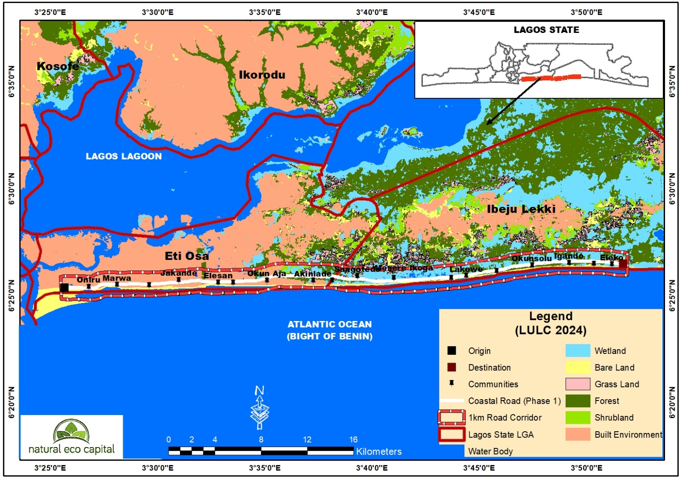
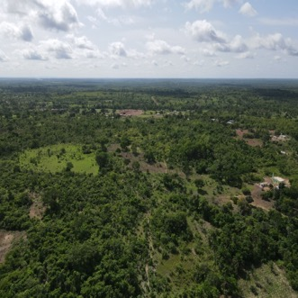
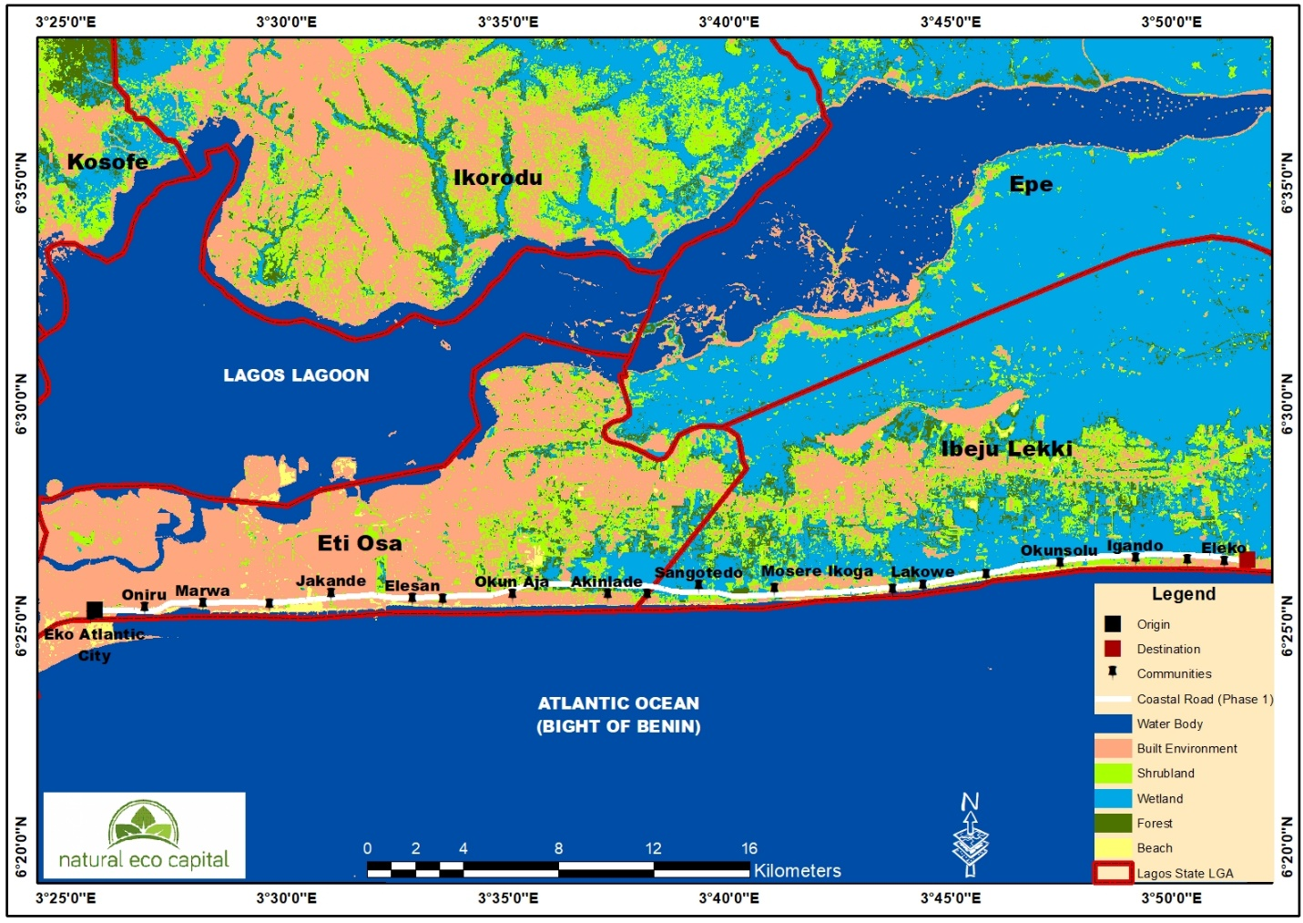

ENVIRONMENTAL CONSIDERATIONS
Comprehensive Environmental and Social Impact Assessment (ESIA) conducted.
Critical Habitat Assessment was not triggered as per IFC PS 6
Drainage System: Designed for a 10-year storm return period, with culverts and RCC pipes ensuring effective runoff management.
Biodiversity conservation through robust reforestation plans and minimizing critical habitat disruptions.
Use of eco-friendly CRCP design for reduced lifecycle emissions.
Incorporation of data from the Integrated Biodiversity Assessment Tool
ENVIRONMENTAL MANAGEMENT - INTERNATIONAL BEST PRACTICES
Environmental Risks
ESMS: BMP, D&BMP, EMP, WPMP, SR&RMP, WWMP, CCLMP, ECMS, SWMP
Waste Generated and Disposed
Air Quality
Wildlife Interaction
Noise Measurements
Vibrations
AIS Removal
Biodiversity Inventory
Vibration Measurements
Spill Clean Ups
Pollution Incidents

Slide 18

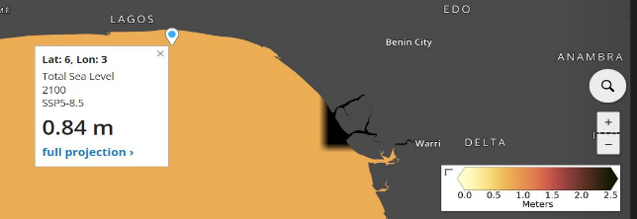
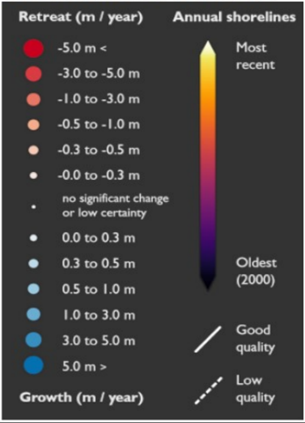
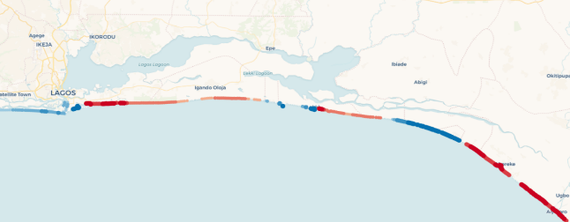
BUILDING RESILIENCE: Climate Change Risk Assessment for the Lagos-Calabar Coastal Highway
Conducted in compliance with IFC Performance Standards and the Equator Principles IV (EPIV).
Resilience against climate-induced risks such as sea-level rise, flooding, and extreme temperatures.
OBJECTIVES:
Key Findings
Physical Risks:
Rising sea levels could reach 0.6m to 1.9m above current levels by 2100 under worst-case scenarios.
Coastal erosion averaging 2.66m/year in critical zones, with areas like Ibeju-Lekki experiencing shoreline retreat.
Increased heavy rainfall may lead to localized flooding and infrastructure stress.
Transition Risks:
Project emissions exceed 100,000 tonnes of CO₂ annually, prompting integration of low-emission strategies.
Compatibility with Nigeria's NDC and Long-Term Low Emission Development Strategy.
The Total Sea level rise projected for year 2100
Accreting and Eroding points along the shorelines in the project area

Slide 19
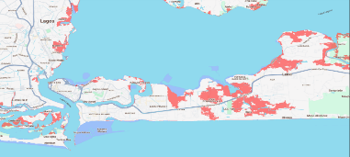
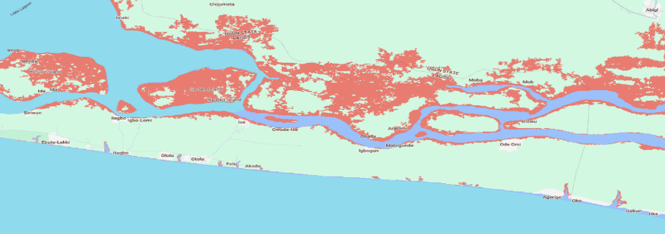
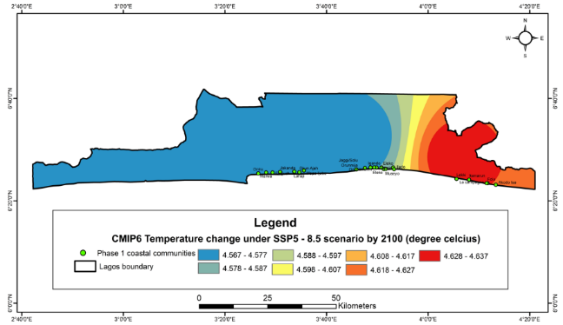
BUILDING RESILIENCE: Climate Change Risk Assessment for the Lagos-Calabar Coastal Highway
Aligns with Nigeria's climate commitments under the Paris Agreement, promoting low-carbon development.
Mitigation and Adaptation Strategies
Engineering Solutions:
Elevating road sections vulnerable to flooding by 2m above projected sea levels.
Implementing advanced drainage systems to manage rainfall intensities exceeding current extremes.
Nature-Based Solutions:
Restoring mangroves to buffer storm surges and erosion.
Stabilizing coastal dunes through vegetation planting.
Community and Policy Integration:
Involving local stakeholders in monitoring and resilience-building initiatives.
Aligning with Nigeria’s Climate Change Act and Energy Transition Plan.
Significance for Lenders and Stakeholders
Demonstrates adherence to global best practices in climate risk mitigation.
Highlights long-term sustainability measures ensuring infrastructure reliability and minimal environmental impact.
Water level above the Mean Higher High Water (mhhw_0p5_m)

Slide 20
HITECH Building climate-resilient infrastructure
Key Area | InfraTech Solutions
Coastal Protection | Nature-Based Solutions: Mangrove forests, seagrass meadows, Innovative Materials: Geotextiles, composite materials for seawalls and breakwaters Early Warning Systems: Real-time monitoring
Flood Management | Sustainable Drainage Systems: Rain gardens, bioswales, permeable pavements Flood Modeling: Advanced modeling techniques Early Warning Systems: Flood alerts for timely evacuation and response
Climate-Proofing Transportation | Elevated Roadways: Construct elevated roadways in flood-prone areas Resilient Materials: Use weather-resistant materials Adaptive Design: Flexible and adaptable infrastructure design
Energy Infrastructure Resilience | Renewable Energy Integration: Solar, wind energy Microgrids: Ensure energy supply during disruptions Smart Grid Technologies: Optimize energy distribution and improve resilience
Urban Planning and Development | Climate-Sensitive Urban Planning: Integrate climate change considerations Green Infrastructure: Parks, green roofs, urban forests
Climate Information Services | Data Collection and Analysis: Monitor climate change impacts Early Warning Systems: Alerts for extreme weather events Climate Modeling: Predict future climate scenarios

Slide 21
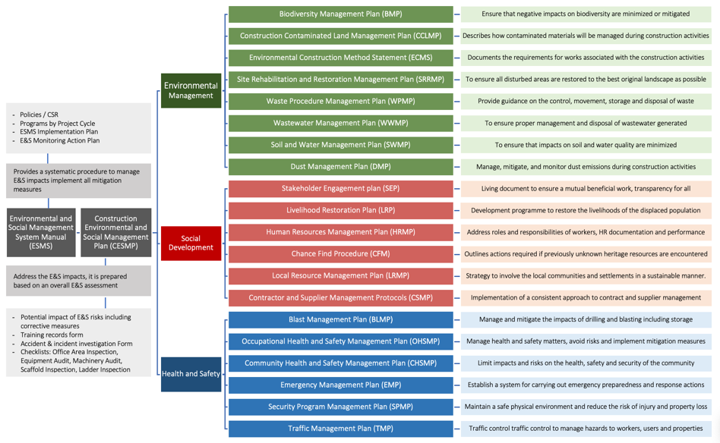


ESMS Dashboard
ESMS

Slide 22
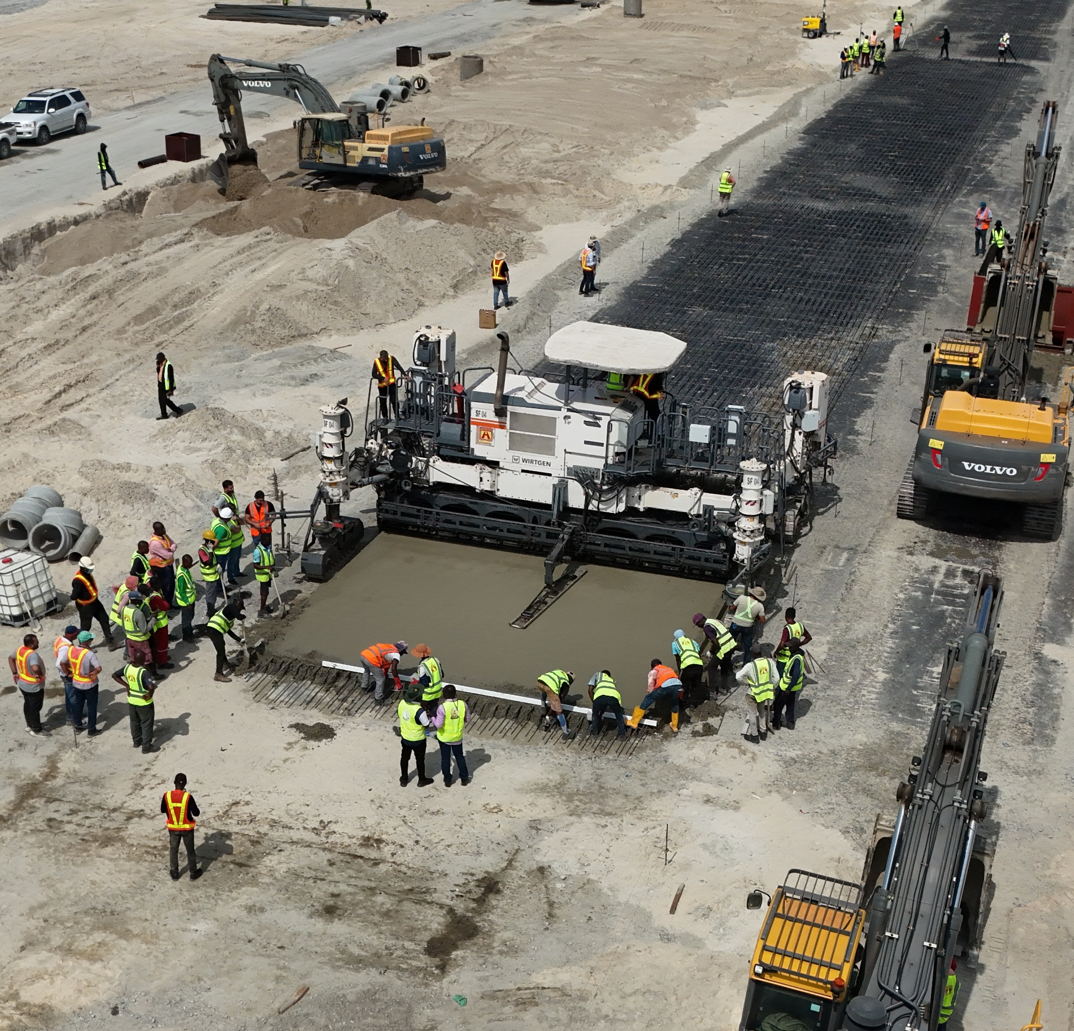
GRIEVANCE REDRESS MECHANISM:
Provides a structured, transparent process to address grievances from workers and community members, aligned with IFC Standards
Accessible and cost-free grievance submission.
Prompt, fair, and transparent resolution.
Ensures no retaliation against complainants.
Receipt of Grievance or Complaint
Submission, reporting or direct capture of grievance
Record
Grievance is recorded in the Grievance Log with a number, and assigning dedicated personnel for its resolution-seeking process
Fact-Finding
Complaint is investigated including inputs and perspecties of parties involved
Resolution or Appeal
Remedial actions are implemented, the claim remains opened for potential appeals
Feedback / Close Out
Feedback from aggrieved is receivedm claim can be closed upon satisfactory outcome
Grievance Submission
Email:
Phone number:
Grievance Form

Slide 23
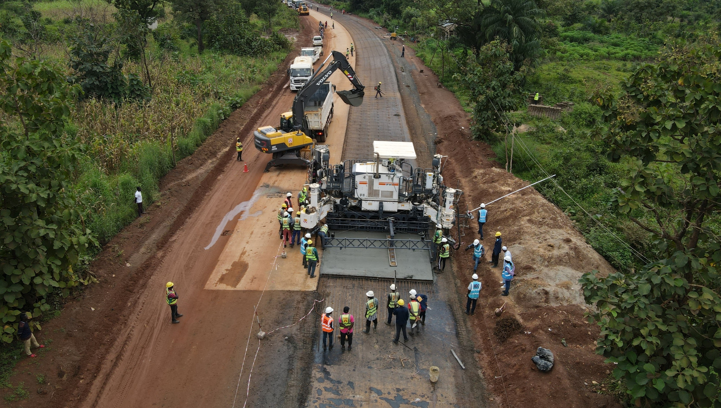

Staff Meetings
H&S Officers, Occupational Doctor and Nurse
Monitoring Logs
Annual Compliance Programme
Near Misses Report
Checklists and Registries
Safety Obs Card
Audit Reports
Obs Whastapp Group
ESMS Dashboard
Daily Inspection TA
Monthly Reports
EHS Survey
Self Montioring Reports
Toolbox Talks
Workers Grievances
Reccomendations
Daily Checklists
Toolbox Talks
Emergency drills
Observations Log
Managers and Workers
Training Programme
Incident Reports
E&S Team
Monthly Reports
Medical Examinations
Consultations

Slide 24
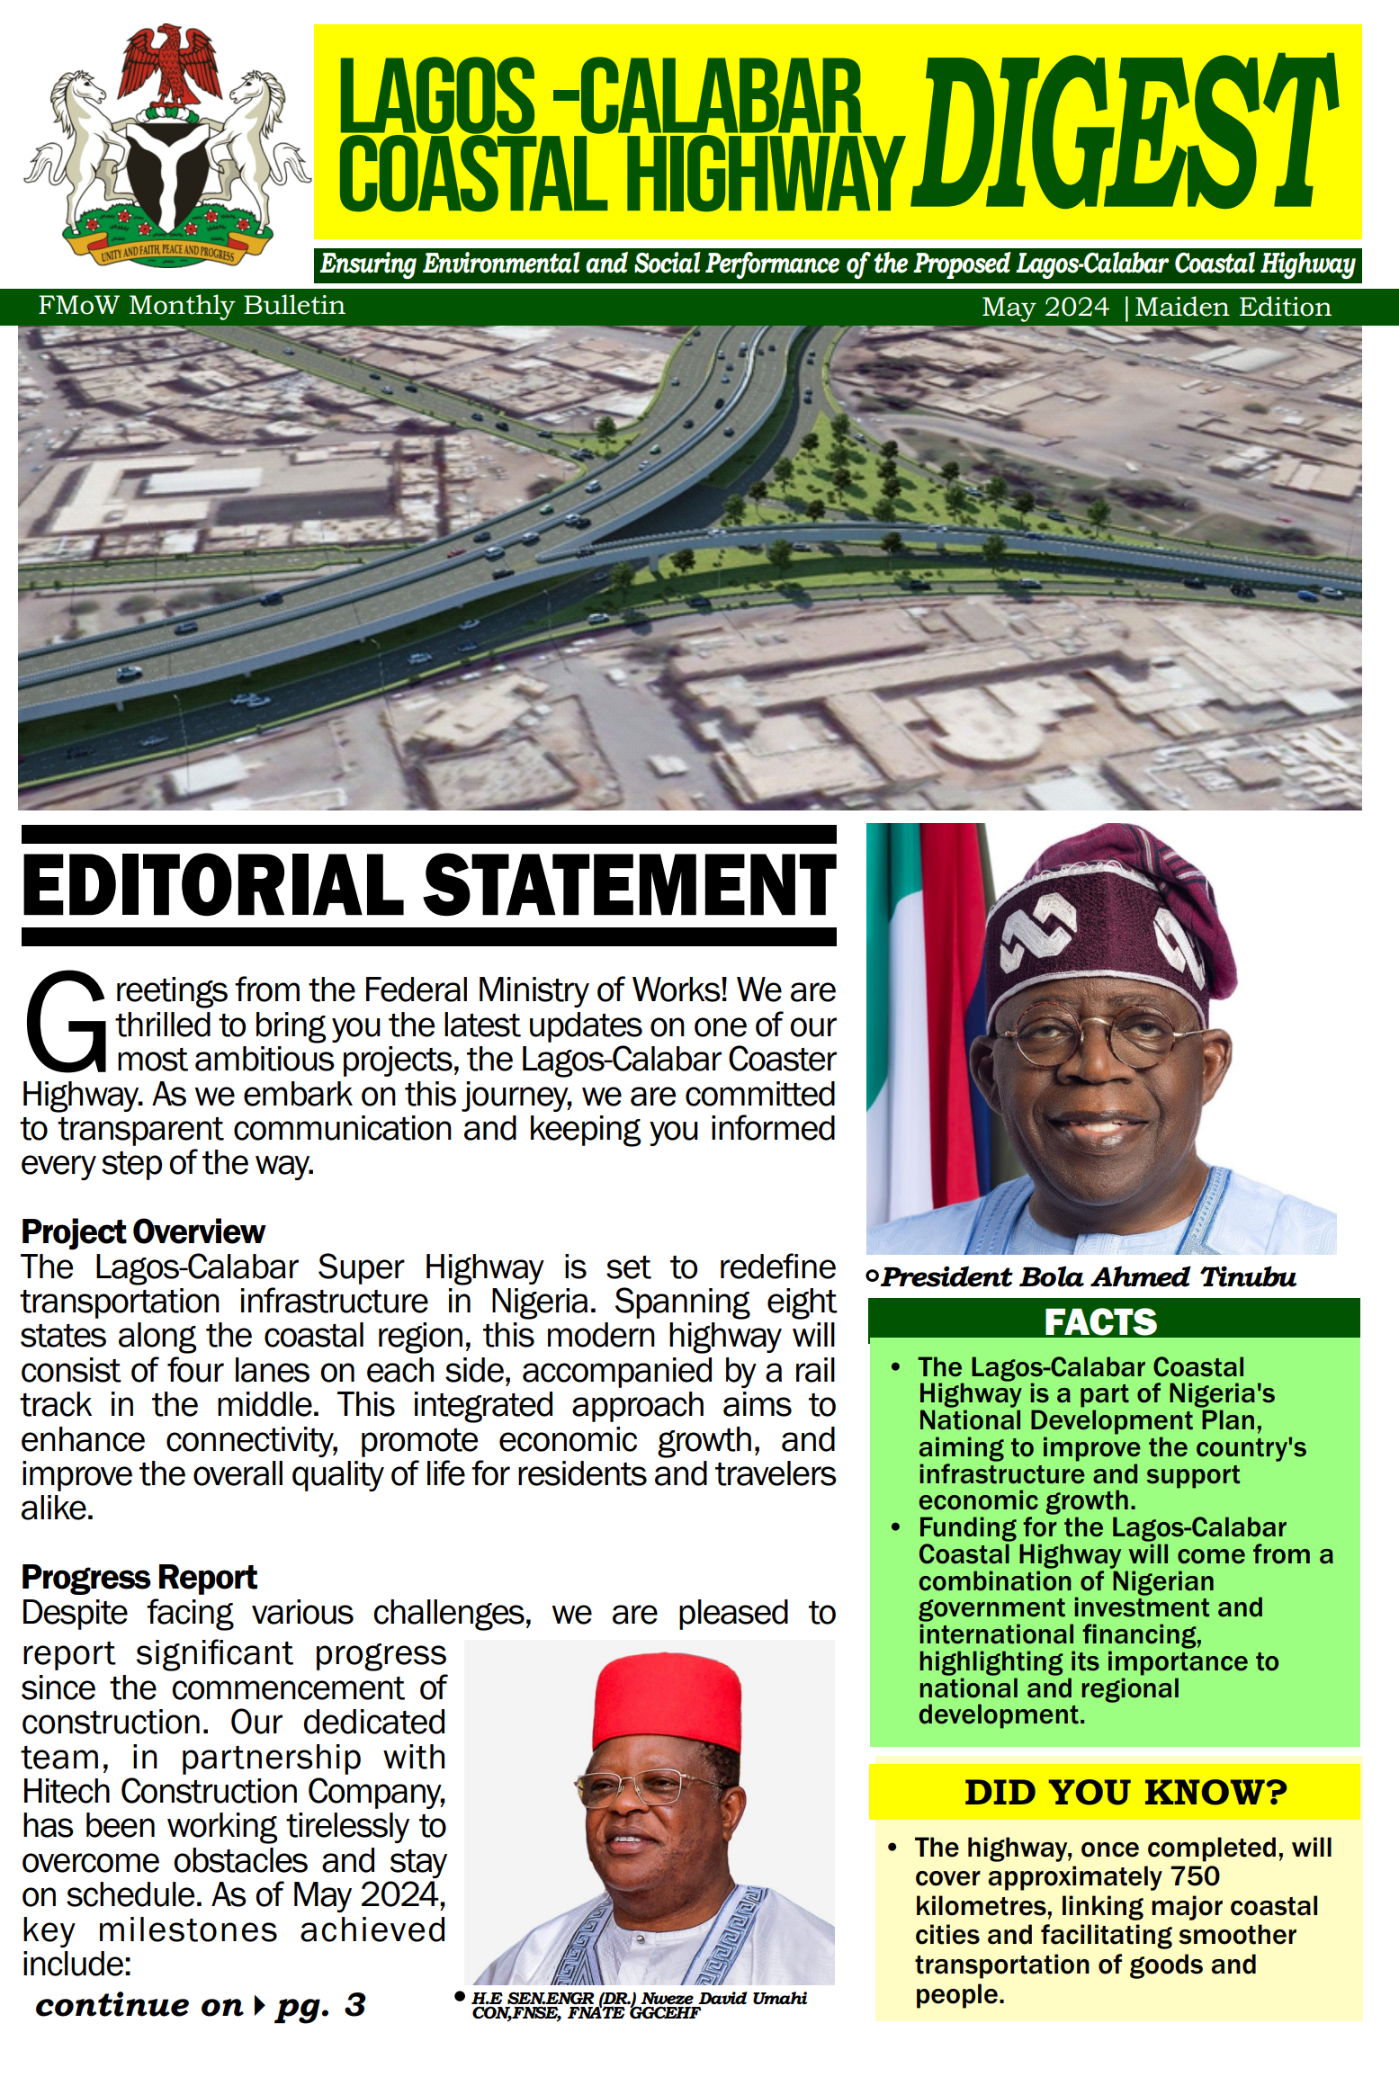
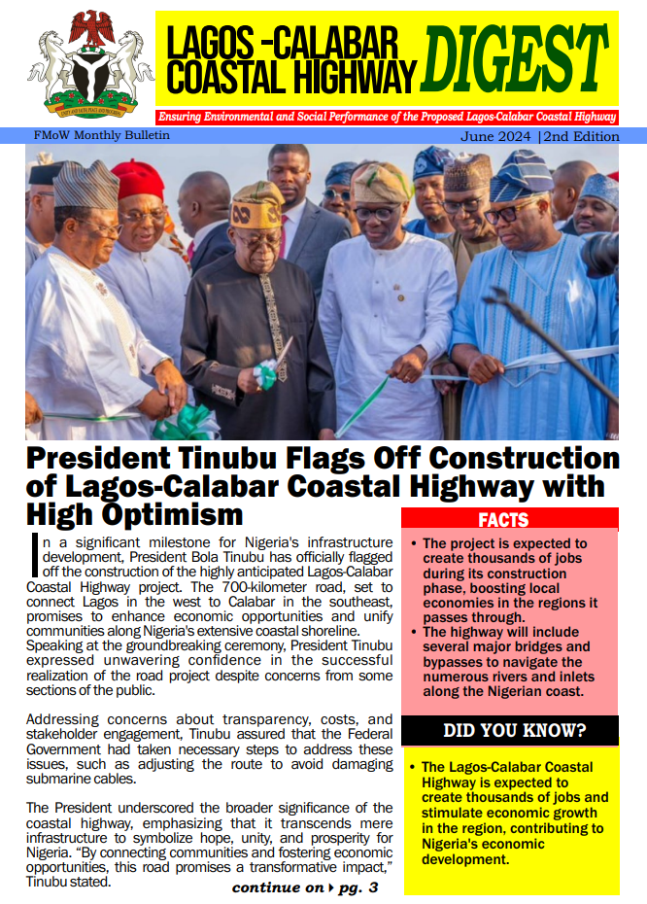
Ensuring Adequacy information to Stakeholders

Slide 25

Transformative opportunity for Nigeria
The project primarily focuses on transportation, however, its positive impact on the environment can contribute to a greener economy:
Reduced Emissions: Efficient transportation reduces carbon emissions, benefiting air quality and overall sustainability.
Promotion of Sustainable Practices: The project can incorporate eco-friendly materials and energy-efficient designs.
Enhanced Livelihoods: Job creation and economic growth can lead to better living standards and increased environmental awareness.

Slide 26

The Project’s Theory of Change
Inputs:
Funding: Financial resources allocated for construction, maintenance, and operation.
Land Acquisition: Land along the coastal route for road construction.
Skilled Labor: Engineers, construction workers, and project managers.
Materials: Cement, asphalt, steel, etc., required for building the highway.
Activities:
Design and Planning: Detailed engineering plans, environmental impact assessments, and alignment studies.
Construction: Building the highway, including earthworks, bridges, tunnels, and drainage systems.
Maintenance: Regular upkeep, repairs, and safety measures.
Outputs:
Physical Infrastructure: Completed highway with multiple lanes, bridges, and train tracks.
Improved Connectivity: Enhanced transportation links between coastal states.
Reduced Travel Time: Shorter distances between cities along the route.
Outcomes:
Economic Growth: Increased trade, investment, and industrial development due to improved connectivity.
Job Creation: Employment opportunities during construction and maintenance.
Environmental Impact: Reduced congestion and pollution as traffic flows more efficiently.
Impacts:
Regional Development: Boosted economic activity, tourism, and urbanization.
Social Well-Being: Better access to healthcare, education, and services.
National Progress: A landmark infrastructure project contributing to Nigeria’s growth and global recognition.
Strategic Planning
The Effects

Slide 27
Green Economy Considerations for the Project
Natural Capital:
The coastal road traverses diverse ecosystems, including mangroves, wetlands, and forests. Proper planning and management can enhance natural capital by preserving biodiversity, carbon sequestration, and ecosystem services.
Blue Economy:
The road connects coastal communities, fishing ports, and maritime activities. It can stimulate the blue economy by improving transportation for fisheries, aquaculture, and marine tourism.
Net Zero:
While not directly tied to the road, achieving net-zero emissions requires sustainable infrastructure. The road’s design, materials, and energy sources impact its carbon footprint.
Green Economy:
The road’s construction and maintenance can align with green economy principles, promoting sustainable practices, job creation, and resource efficiency.
Circular Economy:
Circular design for road materials, waste management, and recycling can minimize environmental impact.
Climate Change:
The road’s resilience to climate-related events (e.g., sea-level rise, storms) is crucial. Mitigation efforts should consider adaptation strategies.
Sustainable Development Goals (SDGs):
The road intersects with various SDGs, including Goal 9 (Infrastructure), Goal 11 (Sustainable Cities), and Goal 13 (Climate Action).

Slide 28
Catalysing Nigeria’s Blue Economy through Lagos-Calabar Coastal Highway
Enhanced Connectivity:
Improved access to ports and markets facilitates sustainable trade in marine resources.
Supports local fisheries and aquaculture, contributing to food security.
Promotion of Tourism:
The highway will enhance eco-tourism and marine tourism opportunities along the coast.
Increases awareness and appreciation for coastal ecosystems, promoting conservation efforts.
Support for Marine Conservation:
Include funding for marine protected areas (MPAs) and habitat restoration in project planning.
Balance infrastructure development with the need to protect marine biodiversity.
Sustainable Resource Management:
Promote renewable energy and environmentally friendly technologies in construction.
Encourage sustainable practices among local businesses and communities.

Slide 29
Lagos-Calabar Coastal Highway - a Catalyst for Nigeria’s Blue Economy
Enhanced Access to Marine Resources:
Improved transportation infrastructure will facilitate the efficient movement of fish and seafood products from coastal areas to markets, promoting sustainable fisheries.
Support for Aquaculture:
Easier access to inputs and markets will encourage investment in sustainable aquaculture practices, contributing to food security and livelihoods.

Slide 30
Lagos-Calabar Coastal Highway - a Catalyst for Nigeria’s Blue Economy
Boosting Coastal Tourism:
The highway can enhance tourism opportunities by providing better access to coastal attractions, fostering eco-tourism, and promoting awareness of marine conservation.
Facilitation of Trade in Marine Products:
Strengthening trade networks for marine goods within Nigeria and with neighboring countries can lead to increased economic activity, benefiting local communities.

Slide 31
Lagos-Calabar Coastal Highway - a Catalyst for Nigeria’s Blue Economy
Sustainable Resource Management: The project encourages collaboration among stakeholders to manage marine and coastal resources sustainably, aligning with Nigeria's broader environmental goals.
Contribution to Policy Frameworks: The highway serves as a strategic infrastructure component within Nigeria's national policies aimed at developing a sustainable blue economy, integrating economic growth with environmental stewardship.
Ministry Holds Workshop On Development Of National Policy For Blue Economy Sector* https://businessinsiderng.com/ministry-holds-workshop-on-development-of-national-policy-for-blue-economy-sector

Slide 32
Contribution to a Sustainable Nigerian Blue Economy- Economic Impact and Vision for Nigeria
Logistics & Connectivity
Cost Reduction:
The Lagos-Calabar Coastal Highway is expected to reduce logistics costs by 25%, significantly lowering the expenses associated with transporting goods across the region.
Annual Savings:
The highway will facilitate savings of approximately $2 billion annually for the manufacturing and export sectors, enhancing Nigeria’s competitive edge in regional and global markets.
Investment Needs:
To fully realize these benefits, an estimated $1 billion investment is required in transport systems, including the development of cold chains to preserve perishable goods and improve supply chain efficiency.

Slide 33
Contribution to a Sustainable Nigerian Blue Economy-Job Creation
Employment Opportunities:
The project is projected to create over 150,000 direct and indirect jobs across various sectors such as construction, logistics, and tourism, contributing to economic stability and growth.
Economic Injection:
An estimated $2 billion annually will flow into the economy through wages and local spending by workers, further stimulating local businesses and communities.

Slide 34
Contribution to a Sustainable Nigerian Blue Economy- Total Projected Economic Impact
GDP Contribution:
The Lagos-Calabar Coastal Highway is anticipated to contribute between $10 billion to $12 billion annually to Nigeria’s GDP within the next ten years, showcasing its potential as a major driver of economic growth.
Key Drivers:
Maritime Efficiency: Improved access to ports will enhance shipping and logistics operations, reducing delays and costs.
Tourism Expansion: Better infrastructure will boost tourism by increasing access to coastal attractions, generating additional revenue and job opportunities.
Fisheries Enhancement: The highway will facilitate the efficient transport of seafood, promoting sustainable fishing practices and enhancing the fisheries sector.

Slide 35
Contribution to a Sustainable Nigerian Blue Economy-Strategic Vision
Positioning Nigeria as a Regional Blue Economy Hub:
The highway aligns with Nigeria’s strategic vision to become a leader in the blue economy, leveraging its vast marine resources and coastal areas for sustainable economic development.
Driving Sustainable Growth:
The project supports sustainable growth by optimizing resource use, enhancing trade routes, and promoting environmental stewardship.
Enhancing Regional Trade:
By improving connectivity and logistics, the highway will facilitate increased trade among African nations, reinforcing Nigeria’s role as an economic powerhouse in the region.

Slide 36
Call to Action
Continued collaboration among stakeholders, including government, communities, and environmental organizations essential
Ongoing monitoring and adaptive management to ensure the project meets its sustainability goals very relevant

Slide 37

Lagos-Calabar Coastal Highway – Anchored on
Technical Soundness:
Rigorous engineering design ensures technical feasibility.
The highway’s construction and operation are sustainable.
Environmental Considerations:
Thorough Environmental impact assessments
Mitigation measures designed to minimize harm.
Economic Viability:
Leveraging private sector resources and funding.
The project’s financial sustainability is assured.
Social and Cultural Acceptance:
The project aligns with societal norms and cultural values.
Communities find it appropriate and acceptable.
Government Commitment:
Key ministries (Federal Ministry of Works, Federal Ministry of Environment, and Federal Ministry of Finance) champion the project.
Regulatory frameworks and flexible financing instruments are actively implemented.

Slide 38
Conclusion
The Lagos-Calabar Coastal Highway Project is a transformative initiative aimed at enhancing regional connectivity and trade
By prioritizing environmental considerations and sustainability, the project aims to contribute positively to Nigeria’s blue economy.
The success of the Lagos-Calabar Coastal Highway Project in contributing to a sustainable blue economy hinges on robust collaboration among all stakeholders and a commitment to ongoing monitoring and adaptive management.
This approach will help maximize benefits while safeguarding environmental health and community well-being.

Slide 39
Thank You
Dr. Eugene Itua,
Lead, Environmental and Social Safeguards,
Lagos-Calabar Coastal Highway
eugeneitua@ecopital.com
November 27, 2024, Port Harcourt, Nigeria

